Slide 1
04 | Visual Studio & ASP.NET Integration
Jon Galloway | Technical Evangelist
Christopher Harrison | Content Developer
Notes:
Browser Link
Templates
What's there by default?
Scaffolding optimization
Changing MVC scaffolding to use Bootstrap classes
Improving File -> New Project
Tools
Web Essentials
Visual Studio Extensions
Top NuGet Packages
Bundling & Minification

Slide 2
Outline
Browser Link
Templates
What's there by default?
Scaffolding optimization
Changing MVC scaffolding to use Bootstrap classes
Improving File -> New Project
Tools
Web Essentials
Visual Studio Extensions
Top NuGet Packages
Bundling & Minification

Slide 3
Browser Link

Slide 4
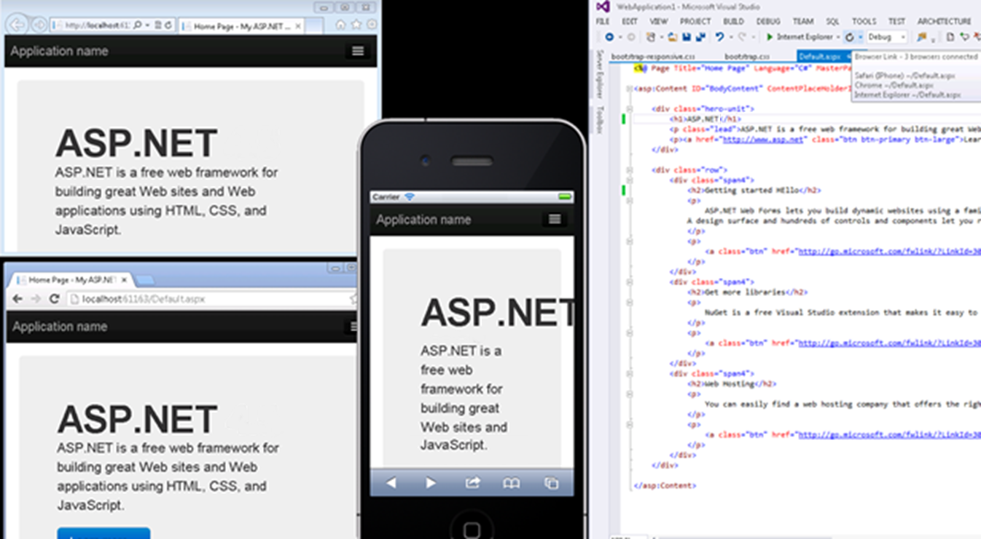
Browser Link

Slide 5
Browser Link

Slide 6
Templates
What’s in the box?

Slide 7
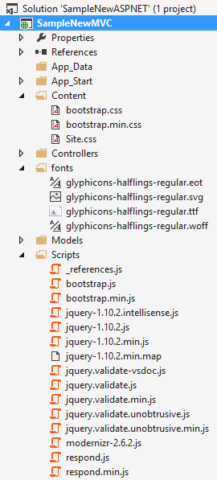
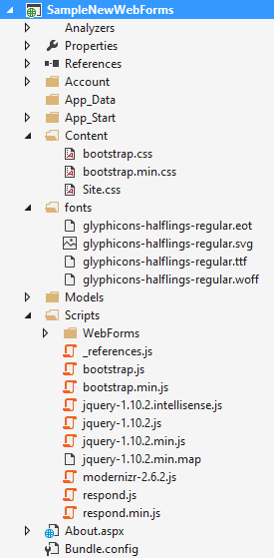
Included files and references
CSS
Bootstrap fonts (glyphicons)
JavaScript
References in Layout / Master

Slide 8
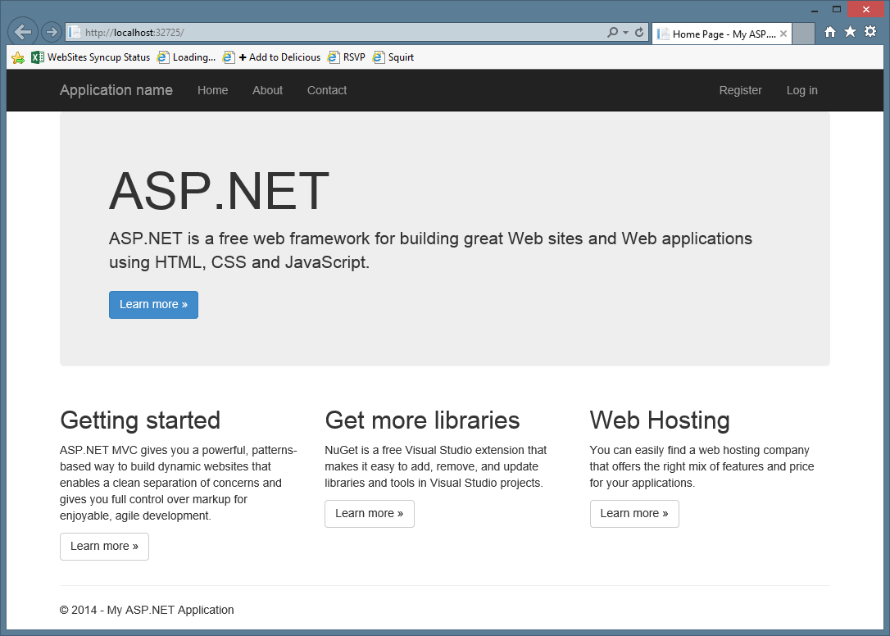

Slide 9
Bootstrapified Templates

Slide 10
Scaffolding Optimization
Notes:
Bootswatch

Slide 11
How to change scaffolding
Per-project: Scaffold Templates
Shared
Project Templates
Custom Scaffolder

Slide 12
What to change
Table classes
Tabs
Groupings
Navigation
Affix
NOT design (that goes in theme / CSS)

Slide 13
Bootstrap - Scaffolding
Notes:
MVC Scaffold templates (using Side Waffle)
Web Forms scaffolding
http://www.asp.net/mvc/tutorials/mvc-4/custom-mvc-templates

Slide 14
Visual Studio support

Slide 15
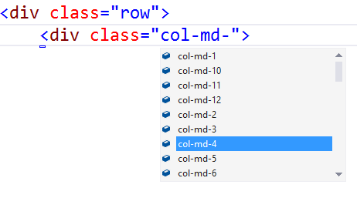
Visual Studio – Class IntelliSense

Slide 16
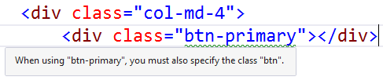
Web Essentials - Missing Class Detection

Slide 17
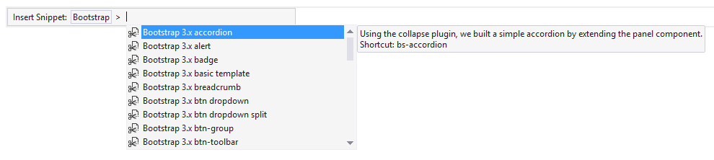
VSIX – Bootstrap Snippet Pack
http://visualstudiogallery.msdn.microsoft.com/e82e7862-f731-4183-a27a-3a44b261bfe5

Slide 18
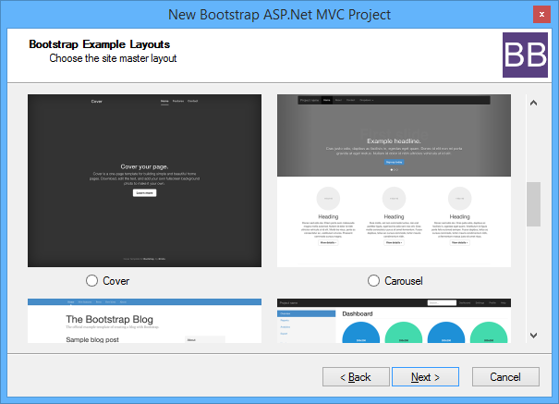
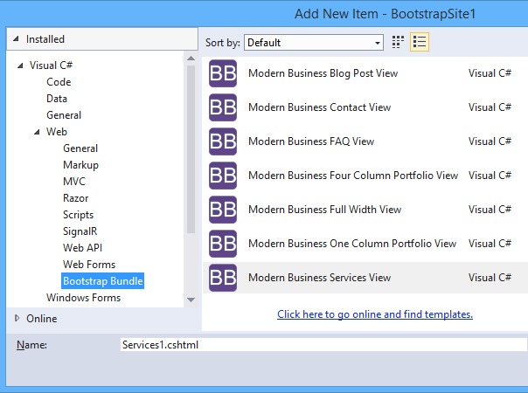
VSIX – Bootstrap Bundle
www.bootstrapbundle.com

Slide 19
Bootstrap – Visual Studio Support

